Slide 1
BDD
Lesson – 7 Selenium Web Driver

Slide 2
Lesson Objectives
Introduction To Web Driver
Writing first Web Driver Test
Locating UI Elements-Developers Tools
Navigation API
Interrogation API
WebElement API
Why synchronization is important
Using Explicit & Implicit Wait
JavaScript Executor

Slide 3
Lesson Objectives (Contd.)
Selenium: How it works
Different drivers
Chrome
Firefox
Internet Explorer
Headless Browser
Ghost Driver and Phantom JS
Mobile Browsers
Selendriod & Appium
Remote Web Driver
Capabilities
Profile setting
Selenium Grid

Slide 4
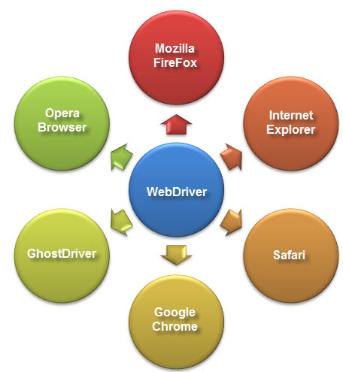
4.1: Selenium 2.0 – Web Driver Introduction To Web Driver
Web automation framework that allows you to execute your tests against different browsers, not just Firefox (unlike Selenium IDE).
Provides a simpler, more concise programming interface
Selenium-WebDriver was developed to better support dynamic web pages where elements of a page may change without the page itself being reloaded
Supply a well-designed object-oriented API that provides improved support for modern advanced web-app testing problems.

Slide 5
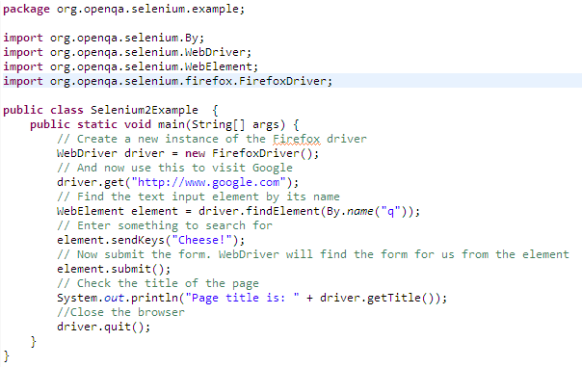
5.1: Testing Web Applications Using Web Driver API Writing first Web Driver Test(Java)

Slide 6
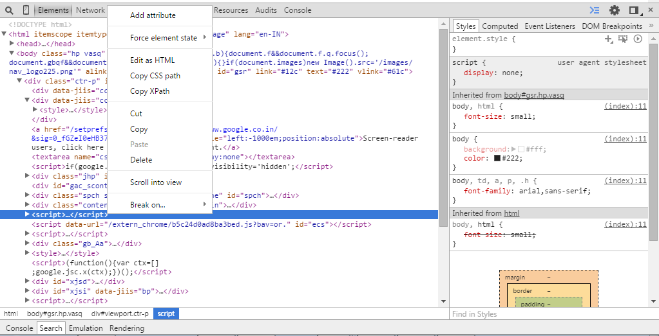
5.1: Testing Web Applications Using Web Driver API Locating UI Elements-Developers Tools

Slide 7
5.1: Testing Web Applications Using Web Driver API Navigation API
driver.get("URL")
Required to navigate to a page
E.g.: driver.get("http://www.google.com");
WebDriver will wait until the page has fully loaded before returning control to your test or script
to ensure page is fully loaded then wait commands can be used
driver.navigate().to("URL")
E.g.: driver.navigate().to("http://www.google.com");
Other Navigate commands
driver.navigate().refresh();
driver.navigate().forward();
driver.navigate().back();
Notes:
Single-Page Applications are an exception to this.
The difference between these two methods comes not from their behavior, but from the behavior in the way the application works and how browser deal with it.
navigate().to() navigates to the page by changing the URL like doing forward/backward navigation.
Whereas, get() refreshes the page to changing the URL.
So, in cases where application domain changes, both the method behaves similarly. That is, page is refreshed in both the cases. But, in single-page applications, while navigate().to() do not refreshes the page, get() do.
Moreover, this is the reason browser history is getting lost when get() is used due to application being refreshed.

Slide 8
5.1: Testing Web Applications Using Web Driver API Interrogation API
driver.getTitle()
Get the title of the current page
driver. getCurrentUrl()
Get the current URL of the browser
driver.getPageSource()
Get the source code of the page
Syntax:
public void testTitleReliability() {
driver.get("https://www.google.com");
boolean title = driver.getTitle().contains("Google");
if(title)
String currentURL = driver.getCurrentUrl();
(If you want to verify a particular text is present or not on the page,do as below)
boolean b = driver.getPageSource().contains("your text");
System.out.println(“Expected title is present ");
else if(!title)
System.out.println(" Expected title is not present"); ");
}

Slide 9
5.1: Testing Web Applications Using Web Driver API WebElement API
findElement:
Used to locate single element and return WebElement object of first occurrences element on web page
If element not found, throw s exception NoSuchElementException
Syntax: findElement(By by)
Example:
WebElement element = driver.findElement(By.id("Home"));
element.click();

Slide 10
5.1: Testing Web Applications Using Web Driver API WebElement API
findElements:
Used to find multiple element on webpage, e.g.: count total number of row in table
Returns List of WebElement object of all occurrences of element
If element not found, returns empty List of WebElement object
Syntax: List element = findElements(By by)
Example:
List {WebElement} element = driver.findElement(By.xpath("//table/tr"));

Slide 11
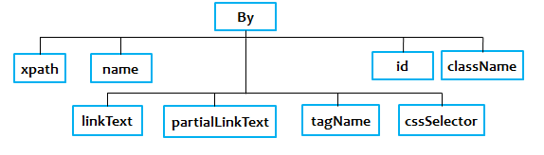
5.1: Testing Web Applications Using Web Driver API WebElement API (Cont..)
By:
A collection of factory functions for creating webdriver.Locator instances
By id: Locates an element by its ID
Syntax: driver.findElement(By.id("element id"))
By className: Locates elements that have a specific class name
Syntax : driver.findElement(By.className("element class"))
By name: Locates elements whose name attribute has the given value
Syntax : driver.findElement(By.name("element name"))

Slide 12
5.1: Testing Web Applications Using Web Driver API WebElement API (Cont..)
By XPath: Locates elements matching a XPath selector.
For example, given the selector "//div", WebDriver will search from the document root regardless of whether the locator was used with a WebElement
Syntax: driver.findElement(By.xpath("xpath expression"))
By linkText :Locates link elements whose visible text matches the given string
Syntax : driver.findElement(By.link("link text"))
By partialLinkText: Locates link elements whose visible text contains the given substring
Syntax : driver.findElement(By. partialLinkText("link text"))
By tagName: Locates elements with a given tag name.
The returned locator is equivalent to using the getElementsByTagName DOM function
Syntax : driver.findElement(By.tagName("element html tag name"))
By CSS Selector: Locates elements with a given tag name.
Syntax : driver.findElement(By.cssSelector("css selector"))
Notes:
CSS selectors for Selenium with example
When we don't have an option to choose Id or Name, we should prefer using CSS locators as the best alternative. CSS is "Cascading Style Sheets" and it is defined to display HTML in structured and colorful styles are applied to webpage.
Selectors are patterns that match against elements in a tree, and as such form one of several technologies that can be used to select nodes in an XML document. Visit to know more W3.Org Css selectors
CSS has more Advantage than Xpath
CSS is much more faster and simpler than the Xpath.
In IE Xpath works very slow, where as Css works faster when compared to Xpath.

Slide 13
5.1: Testing Web Applications Using Web Driver API WebElement API (Cont..)
Click():
For Example: Login button is available on login screen
Syntax:
WebElement click = driver.findElement(By.xpath("//*[@id='btnLogOn']"));
click.click();
Scenarios where Click() is used:
“Check / Uncheck “ a checkbox
Select a radio button
Notes:
Click():
Click a link / button:
To click on an object through webdriver first we need to find out which locator we are going to use. Is it ID, name, xpath, or css? For this purpose we can utilize firebug / xpath checker to find out is there any id / name exists for the object we are going to perform action upon. Then write the code as below:
driver.findElement(By.xpath("//a[@href='CustomerInfo.htm']")).click();
In the above line of code “driver” could be FirefoxDriver, InternetExplorerDriver, ChromeDriver, HtmlUnitDriver, etc. On one of these browsers we are going to find an element and then click as per the code.
findElement is an API provided by the webdriver which requires argument “By.xpath”. The “xpath” can be replaced by one of the below methods if we need to identify the element with any other attributes such as css, name, classname, etc.
“Check / Uncheck “ a checkbox
To “Check / Uncheck” a checkbox, the object needs to be identified using findElement method and then just click. To find out whether the checkbox is checked or not utilize the method – element.isSelected()
WebElement kancheck = driver.findElement(By.name("kannada"));
kancheck.click();
System.out.println(kancheck.isSelected());
Above code snippet will first click the checkbox named kannada and then verifies whether it is clicked or not.

Slide 14
5.1: Testing Web Applications Using Web Driver API WebElement API (Cont..)
Clear():
Function sets the value property of the element to an empty string ('')
Syntax:
driver.findElement(By.xpath("//*[@id=“textBox”]")).clear();
SendKeys():
Method is used to simulate typing into an element, which may set its value
Syntax:
driver.findElement(By.id(“NameTextBox")).sendKeys(“Rahul”);
Notes:
Click():
Click a link / button:
To click on an object through webdriver first we need to find out which locator we are going to use. Is it ID, name, xpath, or css? For this purpose we can utilize firebug / xpath checker to find out is there any id / name exists for the object we are going to perform action upon. Then write the code as below:
driver.findElement(By.xpath("//a[@href='CustomerInfo.htm']")).click();
In the above line of code “driver” could be FirefoxDriver, InternetExplorerDriver, ChromeDriver, HtmlUnitDriver, etc. On one of these browsers we are going to find an element and then click as per the code.
findElement is an API provided by the webdriver which requires argument “By.xpath”. The “xpath” can be replaced by one of the below methods if we need to identify the element with any other attributes such as css, name, classname, etc.
“Check / Uncheck “ a checkbox
To “Check / Uncheck” a checkbox, the object needs to be identified using findElement method and then just click. To find out whether the checkbox is checked or not utilize the method – element.isSelected()
WebElement kancheck = driver.findElement(By.name("kannada"));
kancheck.click();
System.out.println(kancheck.isSelected());
Above code snippet will first click the checkbox named kannada and then verifies whether it is clicked or not.

Slide 15
Notes:
Select a radio button
Follow the same steps which are used in Checkbox to select a radio button and then verify the status using isSelected() method.
WebElement gender = driver.findElement(By.xpath("//input[@name='male']"));
gender.click();
System.out.println(gender.isSelected());
Clear();
The clear() method executes an "Automation Atom", which is a JavaScript function intended to provide the smallest basic unit of automation functionality for a browser. In the case of clear(), that function sets the value property of the element to an empty string (''), then fires the onchange event on the element. The atoms function you're interested in is bot.action.clear()
click
clear
sendKeys
submit
Select – selectByVisibleText etc.
getText
getAttribute

Slide 16
5.1: Testing Web Applications Using Web Driver API WebElement API (Cont..)
SendKeys():
Scenarios where sendKeys() is used:
Sending special characters (Enter , F5, Ctrl, Alt etc..)
Key events to WebDriver
Uploading a file
Syntax:
//Sending Ctrl+A
driver.findElement(By.xpath("//body")).sendKeys(Keys.chord(Keys.CONTROL, "a"));
//Sending pagedown key from keyboard
driver.findElement(By.id("name")).sendKeys(Keys.PAGE_DOWN);
//Sending space key
driver.findElement(By.id("name")).sendKeys(Keys.SPACE);
Submit():
If form has submit button which has type = “submit” instead of type = "button" then .submit() method will work
If button Is not Inside <form> tag then .submit() method will not work.
Syntax:
driver.findElement(By.xpath("//input[@name='Company']")).submit();
Notes:
When to use .click() method
You can use .click() method to click on any button of software web application. Means element's type = "button" or type = "submit", .click() method will works for both.
When to use .submit() method
If you will look at firebug view for any form's submit button then always It's type will be "submit". In this case, .submit() method Is very good alternative of .click() method.

Slide 17
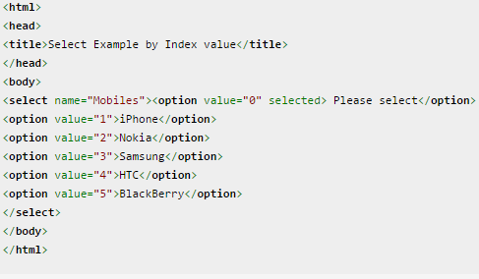
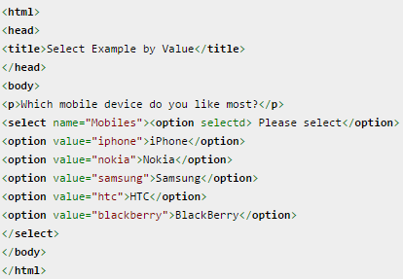
5.1: Testing Web Applications Using Web Driver API WebElement API (Cont..)
Select:
WebDriver’s support classes
Used to work with Dropdowns
Method Name: selectByIndex
Syntax: select.selectByIndex(Index);
Method Name: selectByValue
Syntax: select.selectByValue(Value);
Method Name: selectByVisibleText
Syntax: select.selectByVisibleText(Text);
Notes:
Method Name: selectByIndex
Purpose: To Select the option based on the index given by the user. There is an attribute called "values" which will have the index values.
Example:
WebElement element=driver.findElement(By.name("Mobiles"));
Select se=new Select(element);
se.selectByIndex(1);
Method Name: selectByValue
Purpose: To Select the options that have a value matching with the given argument by the user.
Example:
WebElement element=driver.findElement(By.name("Mobiles"));
Select se=new Select(element);
se.selectByValue("nokia");
Method Name: selectByVisibleText
Purpose: To Select all options that display text matching the given argument. It will not look for any index or value, it will try to match the VisibleText (which will display in dropdown)
Example:
WebElement element=driver.findElement(By.name("Mobiles"));
Select se=new Select(element);
se.selectByVisibleText("HTC");

Slide 18
Notes:
Method Name: deselectByIndex
Purpose: To Deselect the option at the given index. The user has to provide the value of index.
Example:
se.deselectByIndex(1);
Method Name: deselectByValue
Purpose: To Deselect all options that have a value matching the given argument.
Example:
se.deselectByValue("nokia");
Method Name: deselectByVisibleText
Purpose: To Deselect all options that display text matching the given argument.
Example:
se.deselectByVisibleText("HTC");
Method Name: deselectAll
Purpose: To Clear all selected entries. This works only when the SELECT supports multiple selections. It throws NotImplemented eError if the "SELECT" does not support multiple selections. In select it mandatory to have an attribute multiple="multiple“
Example:
se.deselectAll();

Slide 19
5.1: Testing Web Applications Using Web Driver API WebElement API (Cont..)
getText():
Get the text content from a DOM-element found by given selector
Make sure the element you want to request the text from is interact able otherwise empty string is returned
Syntax:
WebElement TxtBoxContent = driver.findElement(By.id(“WebelementID”));
TxtBoxContent.getText();
getAttribute():
getText() will only get the inner text of an element
To get the value, you need to use getAttribute(“attribute name”)
Attribute name can be class, id, name, status etc
Syntax:
WebElement TxtBoxContent = driver.findElement(By.id(WebelementID)); System.out.println("Printing " + TxtBoxContent.getAttribute(“class"));
Notes:
When to use .click() method
You can use .click() method to click on any button of software web application. Means element's type = "button" or type = "submit", .click() method will works for both.
When to use .submit() method
If you will look at firebug view for any form's submit button then always It's type will be "submit". In this case, .submit() method Is very good alternative of .click() method.

Slide 20
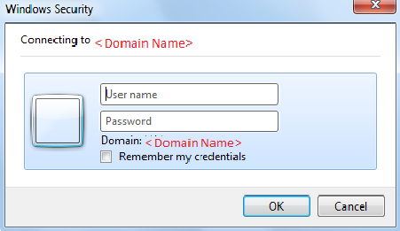
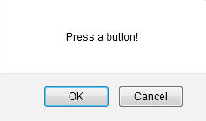
5.1: Testing Web Applications Using Web Driver API Handling Popup Dialogs and Alerts
Two types of alerts:
Windows based alert pop ups
Selenium will not be able to recognize it, since it is an OS-level dialog
Web based alert pop ups
Can be Alert box/ Pop up box/ confirmation Box/ Prompt/ Authentication Box
Alert interface gives us following methods to deal with the alert
accept() : To accept the alert
dismiss() : To dismiss the alert
getText() : To get the text of the alert
sendKeys() : To write some text to the alert
Notes:
Simple alert
Simple alerts just have a OK button on them. They are mainly used to display some information to the user.
Confirmation Alert
This alert comes with an option to accept or dismiss the alert. To accept the alert you can use Alert.accept() and to dismiss you can use the Alert.dismiss().
Prompt Alerts
In prompt alerts you get an option to add text to the alert box. This is specifically used when some input is required from the user. We will use the sendKeys() method to type something in the Prompt alert box.

Slide 21
5.1: Testing Web Applications Using Web Driver API Windows
Multiple windows are handled by switching the focus from one window to another
Syntax:
// Opening site
driver.findElement(By.xpath("//img[@alt='SeleniumMasterLogo']")).click();
// Storing parent window reference into a String Variable
String Parent_Window = driver.getWindowHandle();
// Switching from parent window to child window
for (String Child_Window : driver.getWindowHandles())
{
driver.switchTo().window(Child_Window);
// Performing actions on child window
driver.findElement(By.id("dropdown_txt")).click();
driver.findElement(By.xpath("//*[@id='anotherItemDiv']")).click();
}
//Switching back to Parent Window
driver.switchTo().window(Parent_Window);
//Performing some actions on Parent Window
driver.findElement(By.className("btn_style")).click();
Notes:
Steps for understanding window handling:
Window A has a link "Link1" and we need to click on the link (click event).
Window B displays and we perform some actions.
The entire process can be fundamentally segregated into following steps:
Step 1 : Clicking on Link1 on Window A
A new Window B is opened.
Step 2 : Save reference for Window A
Step 3 : Create reference for Window B
Step 4 : Move Focus from Window A to Window B
Window B is active now
Step 5 : Perform Actions on Window B
Complete the entire set of Actions
Step 6 : Move Focus from Window B to Window A
Window A is active now

Slide 22
5.1: Testing Web Applications Using Web Driver API Alerts
Present in the org.openqa.selenium.Alert package
Syntax:
Alert simpleAlert = driver.switchTo().alert(); //switch from main window to an alert
String alertText = simpleAlert.getText(); //To get the text present on alert
System.out.println("Alert text is " + alertText);
//Simple alert
simpleAlert.accept(); //To click on ‘Ok’/’Yes’ on Alert
OR
//Confirmation Alert
simpleAlert. dismiss(); //To click on ‘Cancel’/’No’ on Alert
OR
//Prompt Alerts
simpleAlert. sendKeys("Accepting the alert"); //Send some text to the alert
Notes:
Alerts are different from regular windows. The main difference is that alerts are blocking in nature. They will not allow any action on the underlying webpage if they are present. So if an alert is present on the webpage and you try to access any of the element in the underlying page you will get following exception: UnhandledAlertException: Modal dialog present

Slide 23
5.1: Testing Web Applications Using Web Driver API Why synchronization is important
“Mechanism which involves more than one components to work parallel with each other”
Every time user performs an operation on the browser, one of the following happens:
The request goes all the way to server and entire DOM is refreshed when response comes back
The request hits the server and only partial DOM gets refreshed (Ajax requests or asynchronous JavaScript calls)
The request is processed on the client side itself by JavaScript functions
So if we think about the overall workflow, there is a need of certain synchronization that happens between the client(aka. browser) and the server (the url)

Slide 24
5.1: Testing Web Applications Using Web Driver API Using Explicit & Implicit Wait
Implicit Wait
Element Synchronization
Default element existence timeout can be set
Below statement will set the default object synchronization timeout as 20
Means that selenium script will wait for maximum 20 seconds for element to exist
If Web element does not exist within 20 seconds, it will throw an exception
driver.manage().timeouts().implicitlyWait(20, TimeUnit.SECONDS);
Notes:
Synchronization can be classified into two categories:
1. Unconditional
2. Conditional Synchronization
Unconditional :
In this we just specify timeout value only. We will make the tool to wait until certain amount of time and then proceed further.
Examples: Wait() and Thread.Sleep();
The main disadvantage for the above statements are, there is a chance of unnecessary waiting time even though the application is ready.
The advantages are like in a situation where we interact for third party systems like interfaces, it is not possible to write a condition or check for a condition. Here in this situations, we have to make the application to wait for certain amount of time by specifying the timeout value.
Conditional Synchronization:
We specify a condition along with timeout value, so that tool waits to check for the condition and then come out if nothing happens.
It is very important to set the timeout value in conditional synchronization, because the tool should proceed further instead of making the tool to wait for a particular condition to satisfy.
In Selenium we have implicit Wait and Explicit Wait conditional statements

Slide 25
5.1: Testing Web Applications Using Web Driver API Using Explicit & Implicit Wait
Explicit Wait
Specific condition synchronization
Instruct selenium to wait until element is in expected condition
Syntax:
WebDriverWait w = new WebDriverWait(driver,20);
w.ignoring(NoSuchElementException.class);
WebElement P = null;
//below statement will wait until element becomes visible P=w.until(ExpectedConditions.visibilityOfElementLocated(By.id("x")));
//below statement will wait until element becomes clickable.
P= w.until(ExpectedConditions.elementToBeClickable(By.id("ss")));
Notes:
Page Load Synchronization:
Default page navigation timeout can be set.
Below statement will set the navigation timeout as 50
Means that selenium script will wait for maximum 50 seconds for page to load
If page does not load within 50 seconds, it will throw an exception
Syntax
driver.manage().timeouts().pageLoadTimeout(50,TimeUnit.SECONDS);

Slide 26
5.1: Testing Web Applications Using Web Driver API JavaScript Executor
An interface which provides mechanism to execute Javascript through selenium driver
Provides “executescript” & "executeAsyncScript" methods, to run JavaScript in the context of the currently selected frame or window
Used to enhance the capabilities of the existing scripts by performing Javascript injection into our application under test
Package import org.openqa.selenium.JavascriptExecutor; Syntax JavascriptExecutor js = (JavascriptExecutor) driver;
js.executeScript(Script,Arguments);
Script - The JavaScript to execute Arguments - The arguments to the script.(Optional)

Slide 27
5.1: Testing Web Applications Using Web Driver API JavaScript Executor(Scenarios)
How to generate Alert Pop window in selenium?
Code:
JavascriptExecutor js = (JavascriptExecutor)driver
Js.executeScript("alert('hello world');");
How to click a button in Selenium WebDriver using JavaScript? Code:
JavascriptExecutor js = (JavascriptExecutor)driver; js.executeScript("arguments[0].click();", element);
How to refresh browser window using Javascript ?
Code:
JavascriptExecutor js = (JavascriptExecutor)driver;
driver.executeScript("history.go(0)");

Slide 28
5.1: Testing Web Applications Using Web Driver API JavaScript Executor(Scenarios)
How to get innertext of the entire webpage in Selenium? Code:
JavascriptExecutor js = (JavascriptExecutor)driver;
String sText = js.executeScript("return document.documentElement.innerText;").toString();
How to get the Title of our webpage ? Code:
JavascriptExecutor js = (JavascriptExecutor)driver;
String sText = js.executeScript("return document.title;").toString();

Slide 29
5.1: Testing Web Applications Using Web Driver API JavaScript Executor(Scenarios)
How to perform Scroll on application using Selenium? Code: JavascriptExecutor js = (JavascriptExecutor)driver; //Vertical scroll - down by 50 pixels js.executeScript("window.scrollBy(0,50)");
Note: for scrolling till the bottom of the page we can use the code: js.executeScript("window.scrollBy(0,document.body.scrollHeight)");

Slide 30
5.1: Testing Web Applications Using Web Driver API JavaScript Executor(Scenarios)
How to click on a Sub Menu which is only visible on mouse hover on Menu? Code: JavascriptExecutor js = (JavascriptExecutor)driver;
//Hover on Automation Menu on the Menu Bar
js.executeScript("$('ul.menus.menu-secondary.sf-js-enabled.sub-menu li').hover()");
How to navigate to different page using Javascript? Code: JavascriptExecutor js = (JavascriptExecutor)driver; //Navigate to new Page js.executeScript("window.location = 'https://www.facebook.com/uftHelp'");

Slide 31







7.1: Selenium Web Driver – Advance Selenium - How it works?
Bindings
Selenium
WebDriver API
Drivers
Java
Firefox
Safari
Ruby
Chrome
Browsers
Python
IE
C#
Opera
Others
Others

Slide 32
7.1: Selenium Web Driver – Advance Different Drivers
Firefox:
WebDriver driver = new FirefoxDriver();
IE:
WebDriver driver = new InternetExplorerDriver();
Chrome:
WebDriver driver = new ChromeDriver();
Safari:
WebDriver driver = new SafariDriver();
Opera:
WebDriver driver = new OperaDriver()
GhostDriver and PhantomJs:
WebDriver driver = new PhantomJSDriver()
Notes:
1. Architecture
WebDriver's architecture is simpler than Selenium RC's.
It controls the browser from the OS level
All you need are your programming language's IDE (which contains your Selenium commands) and a browser.
You first need to launch a separate application called Selenium Remote Control (RC) Server before you can start testing
The Selenium RC Server acts as a "middleman" between your Selenium commands and your browser
When you begin testing, Selenium RC Server "injects" a Javascript program called Selenium Core into the browser.
Once injected, Selenium Core will start receiving instructions relayed by the RC Server from your test program.
When the instructions are received, Selenium Core will execute them as Javascript commands.
The browser will obey the instructions of Selenium Core, and will relay its response to the RC Server.
The RC Server will receive the response of the browser and then display the results to you.
RC Server will fetch the next instruction from your test script to repeat the whole cycle.

Slide 33
Notes:
2. Speed
WebDriver is faster than Selenium RC since it speaks directly to the browser uses the browser's own engine to control it.
Selenium RC is slower since it uses a Javascript program called Selenium Core. This Selenium Core is the one that directly controls the browser, not you.
3. Real-life Interaction
WebDriver interacts with page elements in a more realistic way. For example, if you have a disabled text box on a page you were testing, WebDriver really cannot enter any value in it just as how a real person cannot.
Selenium Core, just like other Javascript codes, can access disabled elements. In the past, Selenium testers complain that Selenium Core was able to enter values to a disabled text box in their tests. Differences in API
4. API
Selenium RC's API is more matured but contains redundancies and often confusing commands.
For example, most of the time, testers are confused whether to use type or typeKeys; or whether to use click, mouseDown, or mouseDownAt. Worse, different browsers interpret each of these commands in different ways tool
WebDriver's API is simpler than Selenium RC's. It does not contain redundant and confusing commands.
5. Browser Support
WebDriver can support the headless HtmlUnit browser
HtmlUnit is termed as "headless" because it is an invisible browser - it is GUI-less.
It is a very fast browser because no time is spent in waiting for page elements to load. This accelerates your test execution cycles.
Since it is invisible to the user, it can only be controlled through automated means.
Selenium RC cannot support the headless HtmlUnit browser. It needs a real, visible browser to operate on.

Slide 34

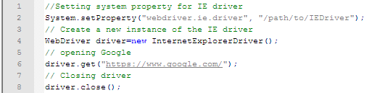
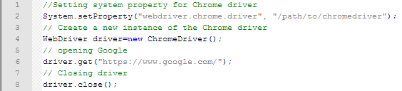
7.1: Selenium Web Driver – Advance Different Drivers (Contd.)
Firefox Driver:
IE Driver:
Chrome Driver:
Notes:
1. Architecture
WebDriver's architecture is simpler than Selenium RC's.
It controls the browser from the OS level
All you need are your programming language's IDE (which contains your Selenium commands) and a browser.
You first need to launch a separate application called Selenium Remote Control (RC) Server before you can start testing
The Selenium RC Server acts as a "middleman" between your Selenium commands and your browser
When you begin testing, Selenium RC Server "injects" a Javascript program called Selenium Core into the browser.
Once injected, Selenium Core will start receiving instructions relayed by the RC Server from your test program.
When the instructions are received, Selenium Core will execute them as Javascript commands.
The browser will obey the instructions of Selenium Core, and will relay its response to the RC Server.
The RC Server will receive the response of the browser and then display the results to you.
RC Server will fetch the next instruction from your test script to repeat the whole cycle.

Slide 35
Notes:
2. Speed
WebDriver is faster than Selenium RC since it speaks directly to the browser uses the browser's own engine to control it.
Selenium RC is slower since it uses a Javascript program called Selenium Core. This Selenium Core is the one that directly controls the browser, not you.
3. Real-life Interaction
WebDriver interacts with page elements in a more realistic way. For example, if you have a disabled text box on a page you were testing, WebDriver really cannot enter any value in it just as how a real person cannot.
Selenium Core, just like other Javascript codes, can access disabled elements. In the past, Selenium testers complain that Selenium Core was able to enter values to a disabled text box in their tests. Differences in API
4. API
Selenium RC's API is more matured but contains redundancies and often confusing commands.
For example, most of the time, testers are confused whether to use type or typeKeys; or whether to use click, mouseDown, or mouseDownAt. Worse, different browsers interpret each of these commands in different ways tool
WebDriver's API is simpler than Selenium RC's. It does not contain redundant and confusing commands.
5. Browser Support
WebDriver can support the headless HtmlUnit browser
HtmlUnit is termed as "headless" because it is an invisible browser - it is GUI-less.
It is a very fast browser because no time is spent in waiting for page elements to load. This accelerates your test execution cycles.
Since it is invisible to the user, it can only be controlled through automated means.
Selenium RC cannot support the headless HtmlUnit browser. It needs a real, visible browser to operate on.

Slide 36
7.1: Selenium Web Driver – Advance Different Drivers (Contd.)
Headless Browser
Web browser without a graphical user interface
Normally, interaction with a website are done with mouse and keyboard using a browser with a GUI
While most headless browser provides an API to manipulate the page/DOM, download resources etc.
So instead of, for example, actually clicking an element with the mouse, a headless browser allows you to click an element by code
Headers, Local storage and Cookies work the same way
List of Headless Browsers
PhanthomJS
HtmlUnit
TrifleJS
Splash
Notes:
Headless browsers are typically used in following situations:
1. You have a central build tool which does not have any browser installed on it. So to do the basic level of sanity tests after every build you may use the headless browser to run your tests.
2. You want to write a crawler program that goes through different pages and collects data, headless browser will be your choice. Because you really don’t care about opening a browser. All you need is to access the webpages.
3. You would like to simulate multiple browser versions on the same machine. In that case you would want to use a headless browser, because most of them support simulation of different versions of browsers. We will come to this point soon.
Things to pay attention to before using headless browser
Headless browsers are simulation programs, they are not your real browsers. Most of these headless browsers have evolved enough to simulate, to a pretty close approximation, like a real browser. Still you would not want to run all your tests in a headless browser. JavaScript is one area where you would want to be really careful before using a Headless browser. JavaScript are implemented differently by different browsers. Although JavaScript is a standard but each browser has its own little differences in the way that they have implemented JavaScript. This is also true in case of headless browsers also. For example HtmlUnit headless browser uses the Rihno JavaScript engine which not being used by any other browser.
Selenium support for headless browser
Selenium supports headless testing using its class called HtmlUnitDriver. This class internally uses HtmlUnit headless browser. HtmlUnit is a pure Java implementation. HtmlUnitWebDriver can be created as mentioned below:
HtmlUnitDriver unitDriver = new HtmlUnitDriver();

Slide 37
7.1: Selenium Web Driver – Advance Different Drivers (Contd.)
PhanthomJS (Headless Browser)
HEADLESS WEBSITE TESTING
Headless Web Kit with JavaScript API
SCREEN CAPTURE
Programmatically capture web contents, including SVG and Canvas
PAGE AUTOMATION
Access and manipulate webpages with the standard DOM API, or with usual libraries like jQuery
Example of interacting with a page using PhantomJS:
page.evaluate(function() {
//Fill in form on page
document.getElementById('Name').value = 'John Doe';
document.getElementById('Email').value = 'john.doe@john.doe';
//Submit
$('#SubmitButton').click();
});

Slide 38
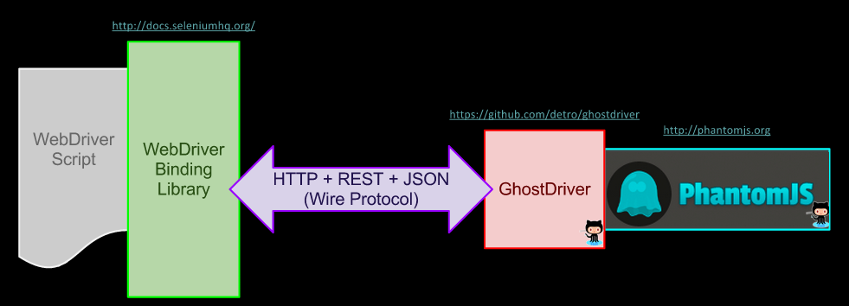
7.1: Selenium Web Driver – Advance Different Drivers (Contd.)
GhostDriver(Headless Browser)
Pure JavaScript implementation of the WebDriver Wire Protocol for PhantomJS Remote
WebDriver that uses PhantomJS as back-end
Notes:
GhostDriver is the project that provides the code that exposes the WebDriver API for use within PhantomJS.
PhantomJS bakes the GhostDriver code into itself, and ships it as part of its downloadable executable.
Thus, to use "GhostDriver" with PhantomJS, only PhantomJS is needed.

Slide 39
7.1: Selenium Web Driver – Advance Different Drivers (Contd.)
Mobile Browsers
Mobile web browsers differ greatly in terms of features offered an operating systems supported
Best can display most websites and offer page zoom and keyboard shortcuts, while others can only display websites optimizes for mobile devices
Appium and Selendroid are the two cross browser mobile automation tool
Appium(Mobile Browser)
Open-source tool for automating native, mobile web, and hybrid applications on iOS and Android platforms, which is handled by a Appium node.js server.
Cross-platform which allows to write tests against multiple platforms (iOS, Android), using the same API
Enables code reuse between iOS and Android test suites
Notes:
Native apps are those written using the iOS or Android SDKs.
Mobile web apps are web apps accessed using a mobile browser (Appium supports Safari on iOS and Chrome or the built-in 'Browser' app on Android). Hybrid apps have a wrapper around a "webview" -- a native control that enables interaction with web content. Projects like Phonegap, make it easy to build apps using web technologies that are then bundled into a native wrapper, creating a hybrid app.
Appium was designed to meet mobile automation needs according to a philosophy outlined by the following four tenets:
You shouldn't have to recompile your app or modify it in any way in order to automate it.
You shouldn't be locked into a specific language or framework to write and run your tests.
A mobile automation framework shouldn't reinvent the wheel when it comes to automation APIs.
A mobile automation framework should be open source, in spirit and practice as well as in name.

Slide 40
7.1: Selenium Web Driver – Advance Different Drivers (Contd.)
Selendroid
Test automation framework which is used Android native & hybrid applications (apps) and mobile web
Full compatibility with the JSON Wire Protocol
No modification of app under test required in order to automate it
Testing the mobile web using built in Android driver webview app
UI elements can be found by different locator types
Selendroid can interact with multiple Android devices (emulators or hardware devices) at the same time
Existing emulators are started automatically
Supports hot plugging of hardware devices
Full integration as a node into Selenium Grid for scaling and parallel testing

Slide 41
7.1: Selenium Web Driver – Advance Remote Web Driver
Implementation class of the WebDriver interface that a test script developer can use to execute their test scripts via the Remote WebDriver server on a remote machine
Needs to be configured so that it can run your tests on a separate machine
If driver is not Remote WebDriver, communication to the web browser is local. So driver will be used as below: Webdriver driver = new FirefoxDriver(); using driver will access Firefox on the local machine, directly
If Remote WebDriver, needs location Selenium Server (Grid) web browser
For example, WebDriver driver = new RemoteWebDriver(new URL("http://localhost:4444/wd/hub"), DesiredCapabilities.firefox());
Notes:
This example assumes that Selenium Server is running on localhost with the default port of 4444. The nice thing about this is you can run Selenium Server on any machine, change the URL to point to the new machine and run the tests. For example, I run the test code from my Mac OS X computer but I run Selenium Server on a Window XP machine. This way I can launch Internet Explorer tests from my Mac OS X computer.

Slide 42
7.1: Selenium Web Driver – Advance Capabilities and Profile Setting
Capabilities describes a series of key/value pairs that encapsulate aspects of a browser
DesiredCapabilities set properties for the WebDriver
Profile used to create custom Firefox profile and use it with desired capabilities
Example to use Firefox profile with desired capabilities:
DesiredCapabilities dc=DesiredCapabilities.firefox();
FirefoxProfile profile = new FirefoxProfile();
dc.setCapability(FirefoxDriver.PROFILE, profile);
Webdriver driver = new FirefoxDriver(dc);

Slide 43
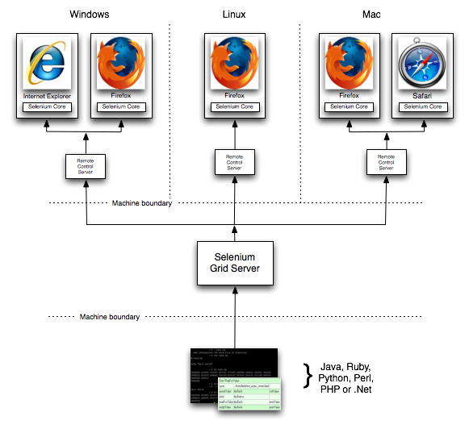
7.1: Selenium Web Driver – Advance Selenium Grid
Allows you run your tests on different machines against different browsers in parallel. That is, running multiple tests at the same time against different machines running different browsers and operating systems. Essentially, Selenium-Grid support distributed test execution. It allows for running your tests in a distributed test execution environment.

Slide 44
Summary
In this lesson, you have learnt
Multiple windows are handled by switching the focus from one window to another.
By is a collection of factory functions for creating webdriver.Locator instances.
Alert contains methods for dismissing, accepting, inputting, and getting text from alert prompts.
Explicit synchronization points are inserted in the script using WebDriverWait class.
Each and every time when there is need to match speed of the application and speed of test execution we have to use thread.sleep().
The implicit wait will not wait for the entire time that is specified, rather it will only wait, until the entire page is loaded.
Notes:
Add the notes here.

Slide 45
Summary
In this lesson, you have learnt
An interface which provides mechanism to execute Javascript through selenium driver
Used to click on a Sub Menu which is only visible on mouse hover on Menu
Used to to get innertext of the entire webpage in Selenium
Used to navigate to different page using Javascript
Used to click a button in Selenium WebDriver using JavaScript
Notes:
Add the notes here.

Slide 46
Summary
In this lesson, you have learnt
In this lesson, you have understood that how the selenium works and interacts with client server.
Different drivers that are available for selenium-Chrome , IE ,Firefox ,headless browsers and mobile browsers.
In remote webdriver the server will always run on the machine with the browser you want to test. And ,there are two ways to user the server: command line or configured in code.
Notes:
Add the notes here.

Slide 47
Summary
Capabilities gives facility to set the properties of browser. Such as to set BrowserName, Platform, Version of Browser.
There are two reasons why you might want to use Selenium-Grid.
To run your tests against multiple browsers, multiple versions of browser, and browsers running on different operating systems.
To reduce the time it takes for the test suite to complete a test pass.
Notes:
Add the notes here.

Slide 48
Review Question
Question 1
Select which is NOT an Explicit Wait
VisibilityOfElementLocated
ElementToBeClickable
PageLoadTimeout
None of the above
Question 2: True/False
The syntax is correct:
Syntax : driver.findElement(By. PartialLinkText("link text"));
Question 3: Fill in the Blanks
findElements is used to find ______ element on webpage

Slide 49
Review Question
Question 4: True/False
The syntax is correct:
Syntax :
JavascriptExecutor js = (JavascriptExecutor)driver;
Question 5: Fill in the Blanks
An interface which provides mechanism to execute ___________ through selenium driver
Notes:
Answer 1:
True
Answer 2:
Javascript

Slide 50
Review Question
Question 6:
PhanthomJS is
Chrome Driver
Mobile Browser
Headless Browser
Firefox Driver
Question 7: True/False
Firefox saves your information such as cookies and browser history in a file called your profile.
Question 8: Fill in the Blanks
Client driver will send the program that is written in eclipse IDE as ________ and send it to Selenium server

